Slide 1
Supervised Learning
Notes:
Intro

Slide 2
Contents
Data Types
Classification vs Regression
Generalization, Overfitting, Underfitting
List the Supervised ML Algorithms
Decision boundaries
Accuracy metrics

Slide 3
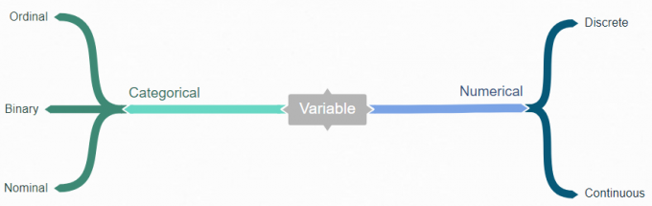
Data Types
Notes:
Ordinal values represent discrete and ordered units. It is therefore nearly the same as nominal data, except that it’s ordering matters
Ex: Educational qualifications
Nominal values represent discrete units and are used to label variables that have no quantitative value. Just think of them as „labels“. Note that nominal data that has no order. Therefore if you would change the order of its values, the meaning would not change
Ex: Gender, Language
We speak of discrete data if the data can only take on certain values. This type of data can’t be measured but it can be counted
You can check by asking the following two questions whether you are dealing with discrete data or not: Can you count it and can it be divided up into smaller and smaller parts?
Continuous values can’t be counted they can be measured

Slide 4

Supervised Learning
Classification
Predicting Student
PASS or FAIL
Regression
Predicting Student
PERCENTAGE
Notes:
the user provides the algorithm with pairs of inputs and desired outputs, and the algorithm finds a way to produce the desired output given an input. In particular, the algorithm is able to create an output for an input it has never seen before without any help from a human.
Classification: Goal is to predict a class a label, which is a choice from a predefined list of possibilities.
Regression: Goal is to predict a continuous number, or a floating point number in programming terms.
In more simpler terms, to distinguish between classification and regression tasks, we just need to check is the output has any ordering or continuity. A problem with ordering or a continuity between possible outcomes then the problem is a regression.

Slide 5
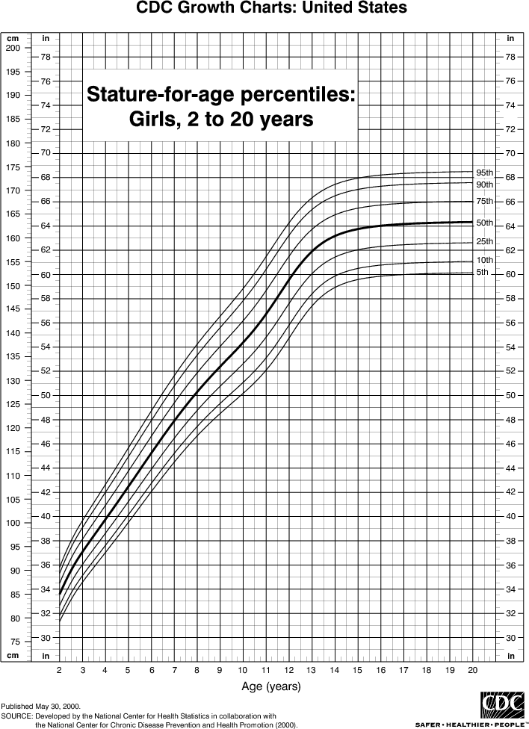
Signal vs Noise
Signal: In predictive modeling Signal
is the true underlying pattern that we
wish our model should learn
Noise: It refers to the irrelevant
information or randomness in a dataset
Modeling height vs. age
Notes:
Above shown picture is derived from a large proportion of population, but if we sample only one local school, the relationship might be misleading or might not give us any valuable information. Their could be outliers in the data,
Eg: A kid whose dad is an NBA player
Eg: A kid who hit puberty at a different age.
Noise in data interferes with the Signal in the data and the job of a well trained ML model is to identify and separate the signal from the noise. But if the model is too complex it can end up “memorizing the noise” instead of the Signal.

Slide 6
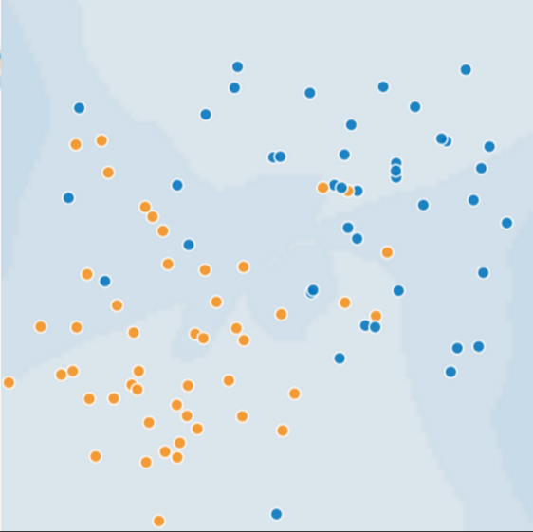
Generalization
Assume that each dot represents a tree in a
forest, blue dots are sick trees and orange
dots are healthy trees.
Can you imagine a good model for predicting subsequent sick or healthy trees? Take a moment to mentally draw an arc that divides the blues from the oranges

Slide 7
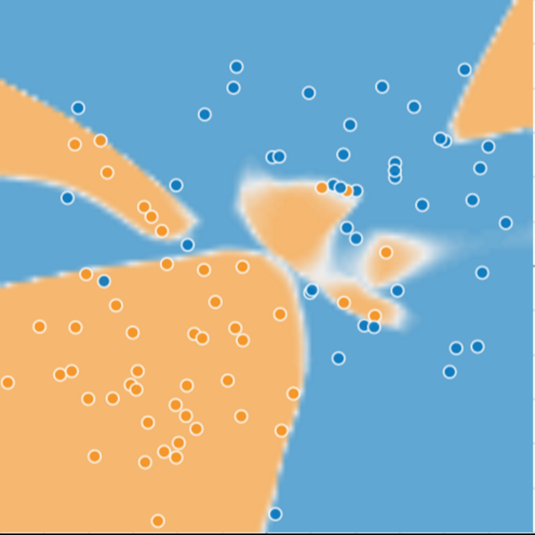
Generalization
Perhaps at this point the decision boundary
we imagined appears to do an excellent job
of separating the blue ones from the orange
ones. Or did it?
Let’s test this boundary over an unseen data.
A complex model for distinguishing sick from healthy trees

Slide 8
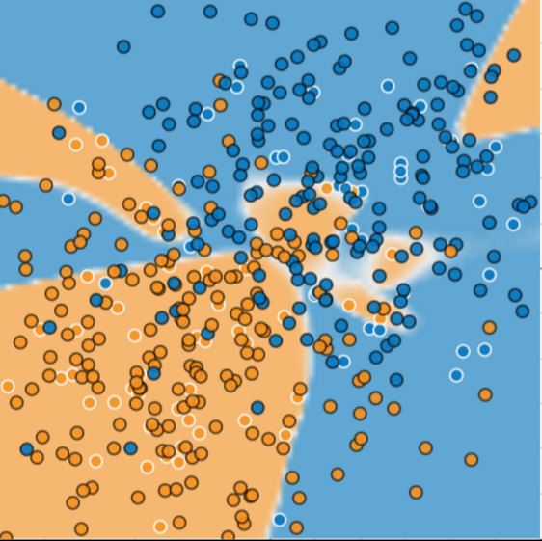
Generalization
It turns out that our model adapted very poorly
to the new data, noticeably model has
miscategorized much of the data points.
Model failed to predict for new data
Notes:
In supervised learning, we want to build a model on the training data and then be able to make accurate predictions on new or unseen data that has more or less the same characteristics of the training set we used. If a model is able to make accurate predictions on unseen data, we say it is able to generalize from the training set to the test set.
Perhaps we always intent to build a model that can generalize as well as possible. As long as the test and train sets have same set of characteristics we can expect our model to make accurate predictions on either datasets.
However if we build a complex model like the one we see above then we can get accurate predictions on train data but the model won’t be able to reflect a real world relationship. Building a complex model does well on training data but doesn’t generalize to test set and we call this situation as overfitting.

Slide 9
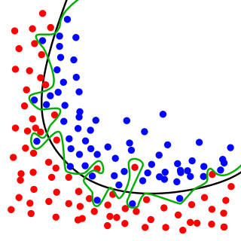
Overfitting
A model that has learned the noise instead of the signal
is considered to overfit since it fits well for training set
but performs poorly for unseen data.
Highly complex / flexible model
Too less data
High variance in the data
Low bias
Black curve generalizes to data by identifying a sound relation in data while the green boundary overfits
Notes:
Overfitting occurs when a model tries to fit the training data so closely that it does not generalize well to new data.
If the key assumptions of supervised ML are not met, then we lose important theoretical guarantees on our ability to predict on new data.
Opposite to this spectrum is the case of Underfittig

Slide 10
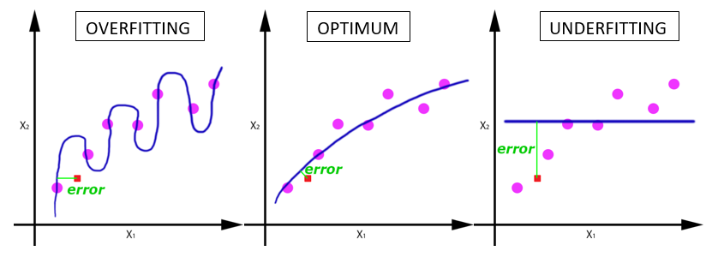
Underfitting
High Bias
Low Variance
Model is not complex enough.
Model has limited flexibility to learn over the Signal in the data.
Notes:
Using too simple a model is called underitting, because we don’t explain the target output for the training data well enough
If we were to fit a linear model for a data that doesn’t have a linear relationship, the model just gives a straight line that could be a best fit for the training set and fails to recognize the actual relation or pattern in the data. Such hypothesis is said to be Underfitting.
Eg: Fitting a Univariate linear regression model on a data which requires us to fit a Multivariate Linear Regression.
Bias reason: hypothesis is biased that the prediction should vary linearly over the feature variation.
To reiterate linear models suffer from a higher bias and tend to have less variance, and polynomial model, on the other hand suffers from a different problem. The model depends a lot on the choice of training data. If you change the data slightly, the shape of the curve will look very different, and the error will swing widely. Therefore, the model is said to have high variance.
Bias and Variance are forms of prediction error in Machine Learning
Typically, we can reduce error from bias but might increase error from variance as a result, or vice versa.

Slide 11
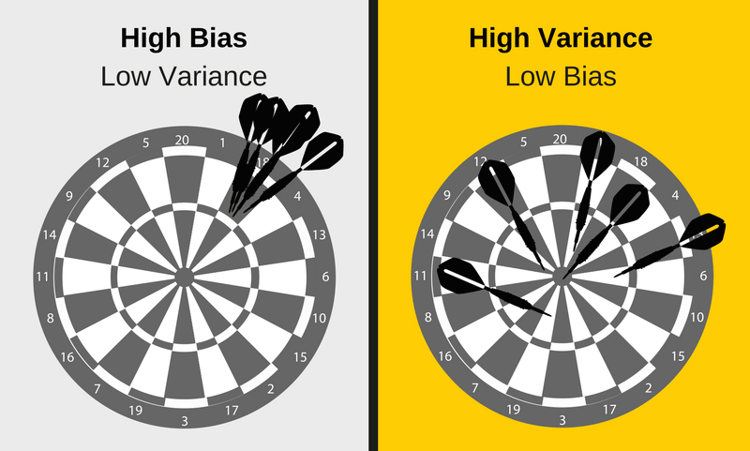
Bias vs Variance
Notes:
This Bias - Variance trade-off can be termed as too simple (high bias) vs. too complex (high variance) is a key concept in statistics and machine learning, and one that affects all supervised learning algorithms.
Assume, you have five different training sets for same problem and you have trained one model for each set.
Undefit: High Bias, low variance, models trained are consistent but are inaccurate.
Overfit: High variance, low bias models that are accurate but inconsistent.
But why do we have trade-off ?
Underfit: Low variance algos tend to be less complex, with simple structure and can’t learn the Signal from the data.
Overfit: Low bias models have more complex/flexible structure and memorize the noise in the data.

Slide 12
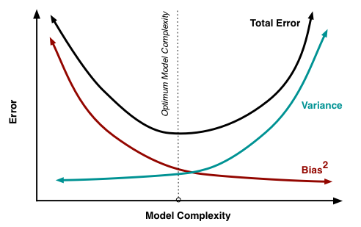
Bias vs Variance
To get good predictions one needs to find a
balance of Bias and Variance to have
optimal performance.
Bias and variance contributing to total error

Slide 13
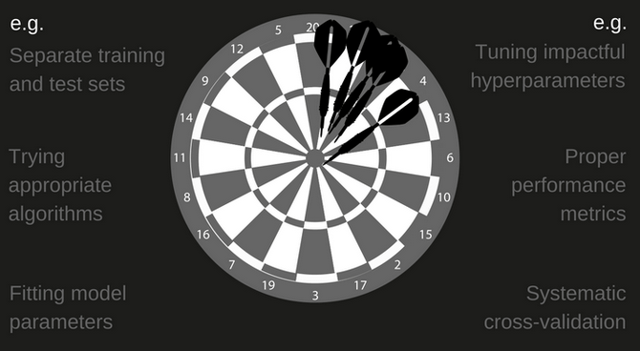
Bias vs Variance
ML workflow to find optimal balance

Slide 14
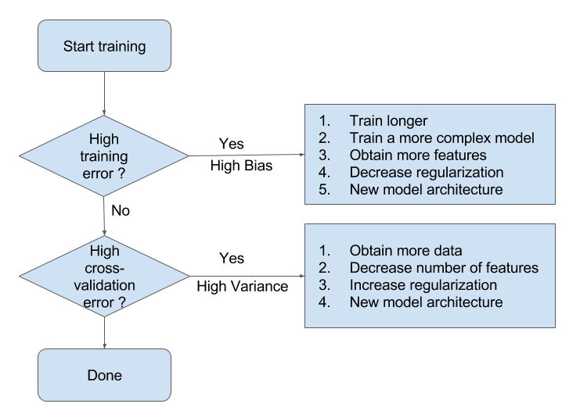
Bias vs Variance
WorkFlow
Notes:
Just a more robust way of representation

Slide 15
List of Supervised Algorithms
Supervised learning
Regression
Classification
Linear Regression
Nearest Neighbors
Nearest Neighbors
Logistic Regression
SVM
Lasso & Ridge Regressions
Naive Bayes
Neural Networks
Decision Trees
Random Forests

Slide 16
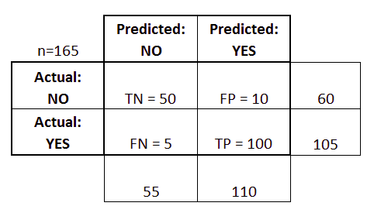
Confusion Matrix
“true positive” for correctly predicted event values.
“false positive” for incorrectly predicted event values.
“true negative” for correctly predicted no-event values.
“false negative” for incorrectly predicted no-event values.
Notes:
A confusion matrix is a summary of prediction results on a classification problem and Is often used to describe the performance of a classifier. It is the most comprehensive way to represent the results of a classifier, Each entry counts for how many data points in the class given by the row the prediction was the class given by the column. Above matrix can now be used to calculate few other metrics.

Slide 17
Accuracy: Overall, how often is the classifier correct?
  (TP+TN)/total = (100+50)/165 = 0.91
Misclassification Rate: Overall, how often is it wrong?
  (FP+FN)/total = (10+5)/165 = 0.09
  equivalent to 1 minus Accuracy
True Positive Rate: When it's actually yes, how often does it predict yes?
  TP/actual yes = 100/105 = 0.95
  also known as "Sensitivity" or "Recall"
False Positive Rate: When it's actually no, how often does it predict yes?
  FP/actual no = 10/60 = 0.17
Specificity: When it's actually no, how often does it predict no?
  TN/actual no = 50/60 = 0.83
  equivalent to 1 minus False Positive Rate
Precision: When it predicts yes, how often is it correct?
  TP/predicted yes = 100/110 = 0.91
Prevalence: How often does the yes condition actually occur in our sample?
  actual yes/total = 105/165 = 0.64
Notes:
Misclassification Rate is also known as "Error Rate"

Slide 18
Q&A

